Slide 1
Test Engineering

Slide 2
"Imagine you download a new app, but every time you try to log in, it crashes. How frustrating would that be?
This is why software testing is crucial—it ensures that software works as expected before users experience it.“
Have you ever faced a software bug?
What do you think happens when software isn't tested properly?

Slide 3
Define Software Testing
simple definition:
"Software testing is the process of evaluating a software application to detect and fix bugs, ensure quality, and verify that it meets requirements."
why testing is important:
Ensures Quality – Prevents failures in real-world usage.
Saves Costs – Fixing bugs early is cheaper than fixing them later.
Builds User Trust – A well-tested software gives a good user experience.

Slide 4
Fundamentals of Software Testing
Software testing is the process of verifying and validating a software application to check whether it:
Meets the specified requirements
Functions correctly without errors
Ensures reliability, performance, and security

Slide 5
Verification vs. Validation:
Verification: Checking if the software is built correctly (Are we building the product right?)
Validation: Checking if the right software is built for the user (Are we building the right product?)

Slide 6
Software Testing Life Cycle (STLC)
1 Requirement Analysis
Understanding requirements
Identifying testable and non-testable requirements
2️ Test Planning
Defining test strategy
Selecting test tools
Estimating effort & cost

Slide 7
3 Test Case Development
Writing test cases & test scripts
Creating test data
4️ Test Environment Setup
Setting up software, hardware, and network configurations

Slide 8
5️ Test Execution
Running test cases
Logging defects & reporting
6️ Test Closure
Preparing test reports
Reviewing lessons learned

Slide 9
Software Testing Lifecycle (STLC)
Requirement Analysis – Understand what needs to be tested. Test Planning – Decide testing strategies and tools. Test Case Development – Write test cases. Environment Setup – Prepare the testing environment. Test Execution – Run tests and report bugs. Test Closure – Review test results and improve processes.

Slide 10
Types of Software Testing
Functional Testing (Validating software behavior)
Unit Testing (Testing individual components)
Integration Testing (Testing how components work together)
System Testing (End-to-end testing of the whole system)
User Acceptance Testing (UAT) (Final validation by users)

Slide 11
Non-Functional Testing (Checking software attributes like performance, security, and usability)
Performance Testing (Speed, load handling)
Security Testing (Identifying vulnerabilities)
Usability Testing (Checking ease of use)
Compatibility Testing (Ensuring it works across devices & browsers)

Slide 12
Levels of Testing
White Box Testing – Internal code structure testing
Black Box Testing – Testing functionality without looking at the code
Gray Box Testing – Combination of both white & black box testing

Slide 13
The two fundamental testing techniques used to evaluate software functionality and internal structure are Black Box Testing and White Box Testing.

Slide 14
Black Box Testing (Functional Testing)
Definition: Black box testing evaluates the software’s functionality without considering its internal code structure or logic. The tester interacts with the application through the user interface and verifies the expected outputs based on given inputs.
Focus: Functional requirements, user interactions, and expected behavior.
Who Performs It: Testers, QA engineers, or end users.

Slide 15
Techniques:
Equivalence Partitioning: Divides input data into valid and invalid partitions to reduce test cases.
Boundary Value Analysis: Tests edge cases by checking values at boundaries (e.g., minimum, maximum, just inside/outside boundaries).
Decision Table Testing: Uses tables to cover different input conditions and their outcomes.
Example:
A login page requires a username and password. A black box tester would test:
Correct login credentials → Successful login.
Incorrect password → Error message.
Blank fields → Validation error.
The tester does not check how the login function is coded, only the outcomes.

Slide 16
White Box Testing (Structural Testing)
Definition: White box testing evaluates the internal structure, logic, and code implementation of the software. The tester has full knowledge of the code and tests the system at the code level.
Focus: Code logic, security vulnerabilities, paths, and internal processing.
Who Performs It: Developers or testers with programming knowledge.

Slide 17
Techniques: Statement Coverage: Ensures every line of code is executed at least once.
Branch Coverage: Tests all possible paths, including if-else and switch conditions.
Path Coverage: Ensures all possible execution paths are tested

Slide 18
Example: Suppose there is a function to calculate discounts
def calculate_discount(price, customer_type):
if customer_type == "VIP":
return price * 0.8 # 20% discount
else:
return price * 0.9 # 10% discount

Slide 19
White box testing would verify:
Whether all conditions (VIP and non-VIP) are covered.
Whether all code statements execute correctly.
If any unhandled exceptions exist.

Slide 20
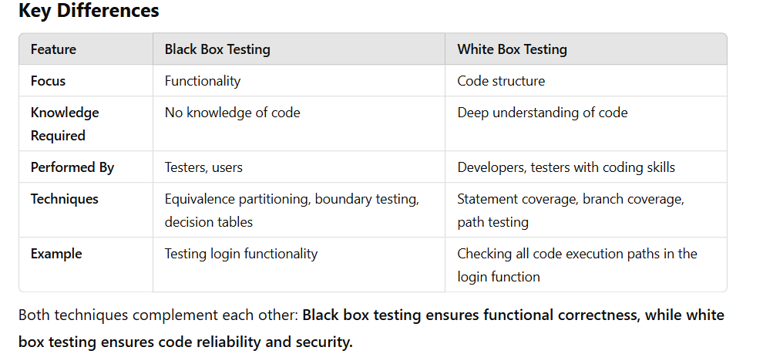

Slide 21
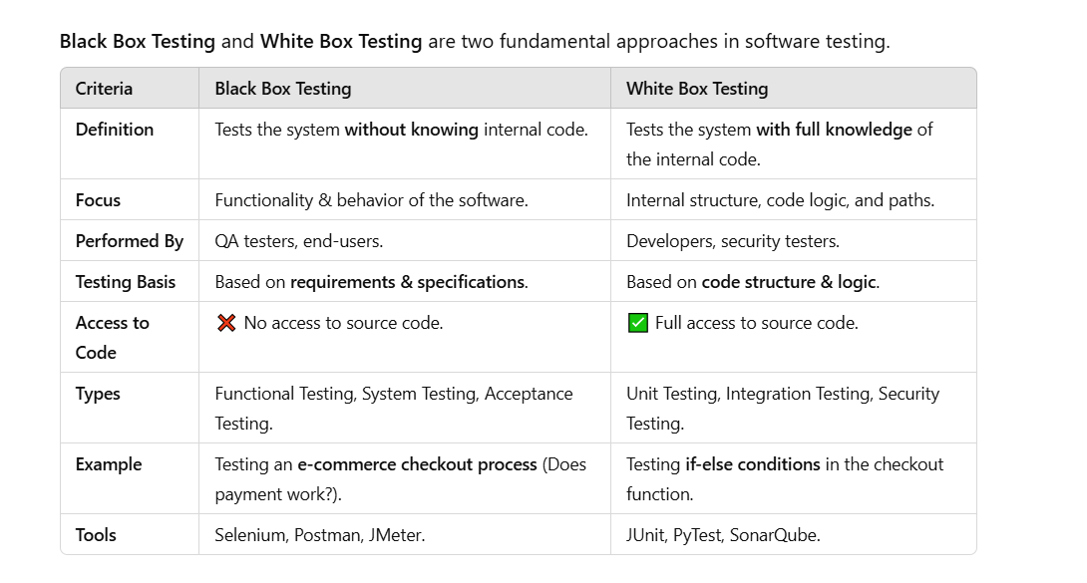
Black Box vs. White Box Testing

Slide 22
Black Box Testing (Functional Testing)
Focuses on what the software does, NOT how it works.
Tester provides inputs → checks if the expected output matches.
Example:
Testing a login page: ✔ Input: Enter correct username & password. ✔ Expected Output: User logs in successfully. ✔ Input: Enter wrong password. ✔ Expected Output: Error message appears.

Slide 23
Common Black Box Testing Techniques:
✔ Equivalence Partitioning – Group similar inputs together. ✔ Boundary Value Analysis – Test minimum & maximum values. ✔ Error Guessing – Predict common mistakes (e.g., leaving a field empty).
Tools:
✅ Selenium (UI Testing) ✅ JMeter (Performance Testing) ✅ Postman (API Testing)

Slide 24
White Box Testing (Code-Based Testing)
Focuses on how the code works internally.
Checks logic, loops, security vulnerabilities, and performance issues.
Example:
Testing the payment function in the backend: ✔ Check if all if-else conditions are covered. ✔ Verify if loops terminate correctly. ✔ Detect security issues like SQL injection.

Slide 25
Common White Box Testing Techniques:
✔ Statement Coverage – Ensure every line of code runs at least once. ✔ Branch Coverage – Test all possible code paths. ✔ Path Coverage – Cover all execution flows.
Tools:
✅ JUnit (Java) ✅ PyTest (Python) ✅ SonarQube (Code Quality Analysis)

Slide 26
Gray Box Testing (Hybrid Approach)
🔹 A mix of Black Box + White Box testing. 🔹 Who performs it? – Testers with partial knowledge of the system. 🔹 Example: API Testing (knowing the request-response format but not the internal implementation).

Slide 27
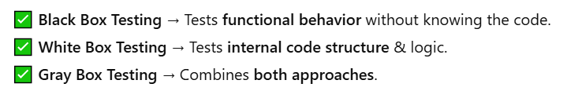

Slide 28
Principles of Software Testing
Testing shows the presence of defects, not their absence
Exhaustive testing is impossible (We can’t test everything!)
Early testing saves time & cost
Defects cluster in certain areas of the software
The pesticide paradox (Reusing the same tests won't find new bugs)
Testing is context-dependent (Different software needs different tests)
Absence of errors is a fallacy (A bug-free product may still not meet user needs)

Slide 29
Manual vs. Automation Testing
Manual Testing: Performed by testers manually (Good for exploratory, usability & ad-hoc testing)
Automation Testing: Uses scripts/tools (Good for repetitive & regression tests)
Popular Automation Tools:
✔ Selenium (Web automation)
✔ Cypress (Web testing)
✔ Appium (Mobile automation)
✔ JMeter (Performance testing)

Slide 30
Bug Life Cycle
Every defect found in testing goes through the following stages: 🔹 New → Assigned → In Progress → Fixed → Retested → Closed

Slide 31
Importance of Software Testing
✔ Improves software quality ✔ Detects bugs early to save time & cost ✔ Ensures security & reliability ✔ Enhances user experience

Slide 32
Different Levels of Software Testing
Software testing is conducted at multiple levels to ensure the quality, functionality, and performance of an application. The main four levels of testing are:
1️⃣ Unit Testing (Testing individual components) 2️⃣ Integration Testing (Testing interactions between components) 3️⃣ System Testing (Testing the entire application) 4️⃣ Acceptance Testing (Validating with end-users or clients)

Slide 33
Unit Testing (Lowest Level of Testing)
What is it?
Tests individual components (functions, classes, modules).
Ensures that each unit works independently.
Performed by developers before integration.

Slide 34
What is Unit Testing?
Unit Testing is a type of software testing where individual components or modules of an application are tested in isolation to ensure they function correctly.
✅ It is performed by developers or testers during the development phase. ✅ It helps in early bug detection, reducing cost & effort in later stages.

Slide 35
Why is Unit Testing Important?
✔ Ensures each module works independently ✔ Catches bugs early in development ✔ Makes debugging easier ✔ Improves code quality and maintainability ✔ Helps in refactoring & scalability

Slide 36
Unit Testing Process
1️⃣ Write a Test Case – Define inputs & expected outputs. 2️⃣ Execute the Test – Run the test to check if the function works. 3️⃣ Check Results – Compare actual vs. expected output. 4️⃣ Fix Bugs – If the test fails, fix the function & retest. 5️⃣ Repeat – Keep testing after every small change.

Slide 37
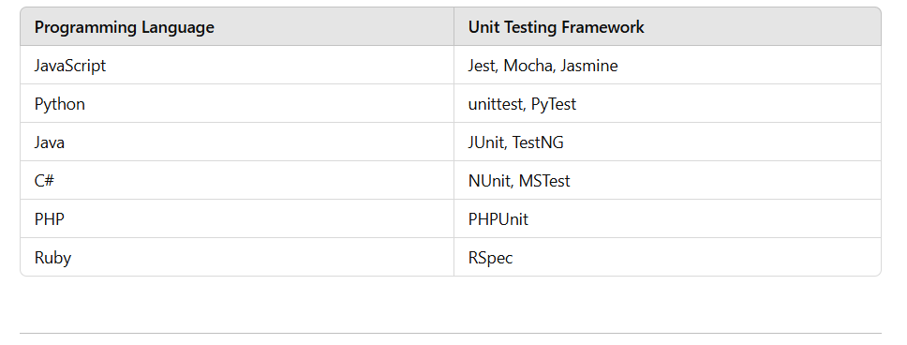
Unit Testing Frameworks & Tools

Slide 38
Testing a login function to check if it correctly validates user credentials.

Slide 39
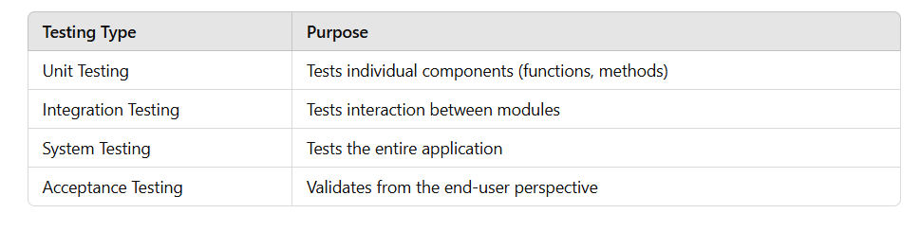

Slide 40
Challenges in Unit Testing
⚠️ Difficult for legacy code without modularity ⚠️ Hard to test UI components ⚠️ Time-consuming if not automated

Slide 41
Integration Testing
Tests how different modules/components interact with each other.
Detects issues in data flow & API communication.
Performed after unit testing.

Slide 42
Example:
Testing if a payment gateway correctly integrates with an order system.

Slide 43
Types of Integration Testing:
Integration Testing ensures that different modules or components of a software system work together correctly. It comes in different types based on how the components are combined and tested
Top-Down Testing: Test higher-level modules first. Bottom-Up Testing: Test low-level modules first. Big Bang Testing: Test all modules at once (risky).
Incremental Testing: Test one module at a time.
Tools:
Postman (API Testing) SoapUI (Web Services Testing) JUnit (Java)

Slide 44
Big Bang Integration Testing
🔹 All modules are integrated simultaneously, and the entire system is tested as a whole. ✔️ Pros: Simple and saves time in small projects. ❌ Cons: Difficult to pinpoint errors, as everything is tested at once.
💡 Example: Testing a complete e-commerce system after integrating the cart, payment, and order modules all at once.

Slide 45
Top-Down Integration Testing
🔹 Testing starts with the high-level modules and progresses down to the lower-level modules. 🔹 Uses stubs (dummy modules) to simulate missing components.
✔️ Pros: Helps in early detection of design flaws. ❌ Cons: Lower-level modules are not tested early.
💡 Example: Testing a banking app by first integrating the dashboard module, then adding the transaction module, and finally the account details module.

Slide 46
Bottom-Up Integration Testing
🔹 Testing begins with lower-level modules and moves up to higher-level modules. 🔹 Uses drivers (temporary programs) to simulate higher-level components.
✔️ Pros: Critical components are tested early. ❌ Cons: GUI-related issues may be discovered late.
💡 Example: In a hospital management system, first testing the database module, then integrating the patient management system, and finally linking it with the hospital dashboard.

Slide 47
Sandwich (Hybrid) Integration Testing
🔹 A combination of Top-Down and Bottom-Up approaches. 🔹 Testing happens at both the top and bottom levels simultaneously, meeting in the middle.
✔️ Pros: Faster testing with the advantages of both approaches. ❌ Cons: Can be complex and resource-intensive.
💡 Example: In a banking system, testing both the user interface and backend transactions simultaneously before linking them together.

Slide 48
Incremental Integration Testing
🔹 Modules are tested one by one and integrated gradually. 🔹 Bugs are fixed after each integration step.
✔️ Pros: Easier to identify defects. ❌ Cons: Takes longer than Big Bang testing.
💡 Example: In a messaging app, first testing the login module, then adding the chat feature, and later integrating the video call feature step by step.

Slide 49
Each integration testing type is useful depending on the project size, complexity, and requirements. Incremental testing is commonly preferred as it allows early bug detection.

Slide 50
Types of Integration Testing
Integration Testing ensures that different modules or components of a software system work together correctly. It comes in different types based on how the components are combined and tested.

Slide 51
System Testing
Tests the entire application as a whole.
Ensures the system meets functional and non-functional requirements.
Performed by QA testers.

Slide 52
Example:
Testing an e-commerce website to check: ✔ Can users add/remove items from the cart? ✔ Does the checkout process work correctly? ✔ Is the website responsive on mobile & desktop?

Slide 53
Types of System Testing:
✔ Functional Testing – Verifies business logic. ✔ Non-Functional Testing – Tests performance, security, usability.
🛠 Tools:
✅ Selenium (Web UI Automation) ✅ JMeter (Performance Testing) ✅ Appium (Mobile Testing)

Slide 54
Acceptance Testing (Highest Level of Testing)
Ensures the software meets business requirements.
Performed by end-users, clients, or stakeholders.
Final step before deployment.
✅ Types of Acceptance Testing:
✔ Alpha Testing: Done before releasing to users. ✔ Beta Testing: Done after releasing to a small group of users.
🛠 Example:
A retail company tests an online shopping platform before launching to customers.
🛠 Tools:
✅ TestRail (Test Case Management) ✅ Jira (Bug Tracking)

Slide 55
